Slide 1
Disjoint set union (DSU)

Slide 2
Disjoint set union (DSU)
We are given several elements, each of which is a separate set.
A Disjoint set union (DSU) have a following operation over given elements:
Add element to a set.
Combine any two sets.
Tell in which set a specific element is.

Slide 3
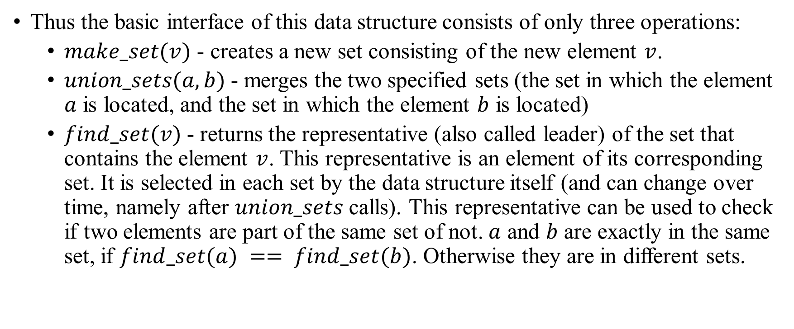
Disjoint set union (DSU)
Thus the basic interface of this data structure consists of only three operations:
$make_set(v)$ - creates a new set consisting of the new element $v$.
$union_sets(a, b)$- merges the two specified sets (the set in which the element $a$ is located, and the set in which the element $b$ is located)
$find_set(v)$- returns the representative (also called leader) of the set that contains the element $v$. This representative is an element of its corresponding set. It is selected in each set by the data structure itself (and can change over time, namely after $union_sets$ calls). This representative can be used to check if two elements are part of the same set of not. $a$ and $b$ are exactly in the same set, if $find_set(a) == find_set(b)$. Otherwise they are in different sets.

Slide 4
Disjoint set union (DSU)
As described in more detail later, the data structure allows you to do each of these operations in almost O(1) time on average.
We will store the sets in the form of trees: each tree will correspond to one set. And the root of the tree will be the representative/leader of the set.

Slide 5
Disjoint set union (DSU) Example
At the beginning every element starts as a single set, therefore each vertex is its own tree.
1
2
3
4
5
6

Slide 6
Disjoint set union (DSU) Example
Then we combine the set containing the element 1 and the set containing the element 2.
1
3
4
5
6
2

Slide 7
Disjoint set union (DSU) Example
Then we combine the set containing the element 3 and the set containing the element 4.
1
3
5
6
2
4

Slide 8
Disjoint set union (DSU) Example
Then we combine the set containing the element 5 and the set containing the element 4.
1
3
5
6
2
4

Slide 9
Disjoint set union (DSU) Example
And in the last step we can the sets containing the elements 1 and 3 are merged.
1
3
5
6
2
4

Slide 10
Disjoint set union (DSU) Example
For the implementation this means that we will have to maintain an array parent that stores a reference to its immediate ancestor in the tree.
1
3
5
6
2
4

Slide 11
Disjoint set union (DSU) Naive implementation
We can already describe the first implementation of the Disjoint Set Union data structure.
It will be pretty inefficient at first, but later we can improve it using two optimizations, so that it will take nearly constant time for each function call.
As we said, all the information about the sets of elements will be kept in an array parent.

Slide 12

Disjoint set union (DSU)
To create a new set (operation $make_set(v)$), we simply create a tree with root in the vertex $v$, meaning that it is its own ancestor.
element | 0 | 1 | 2 | 3 | 4 | 5 | 6 | 7 | 8
parent | 0 | 1 | 2 | 3 | 4 | 5 | 6 | 7 | 8

Slide 13
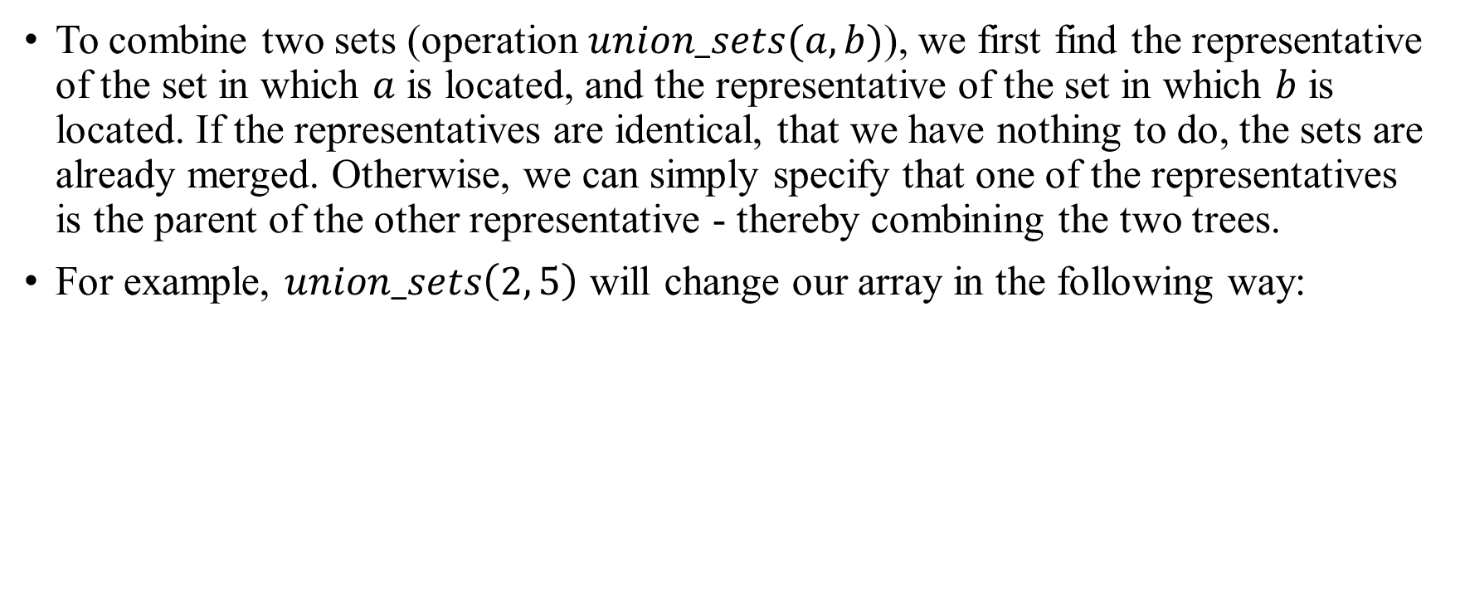
Disjoint set union (DSU)
To combine two sets (operation $union_sets(a, b)$), we first find the representative of the set in which $a$ is located, and the representative of the set in which $b$ is located. If the representatives are identical, that we have nothing to do, the sets are already merged. Otherwise, we can simply specify that one of the representatives is the parent of the other representative - thereby combining the two trees.
For example, $union_sets\left(2, 5\right)$ will change our array in the following way:
element | 0 | 1 | 2 | 3 | 4 | 5 | 6 | 7 | 8
parent | 0 | 1 | 5 | 3 | 4 | 5 | 6 | 7 | 8

Slide 14
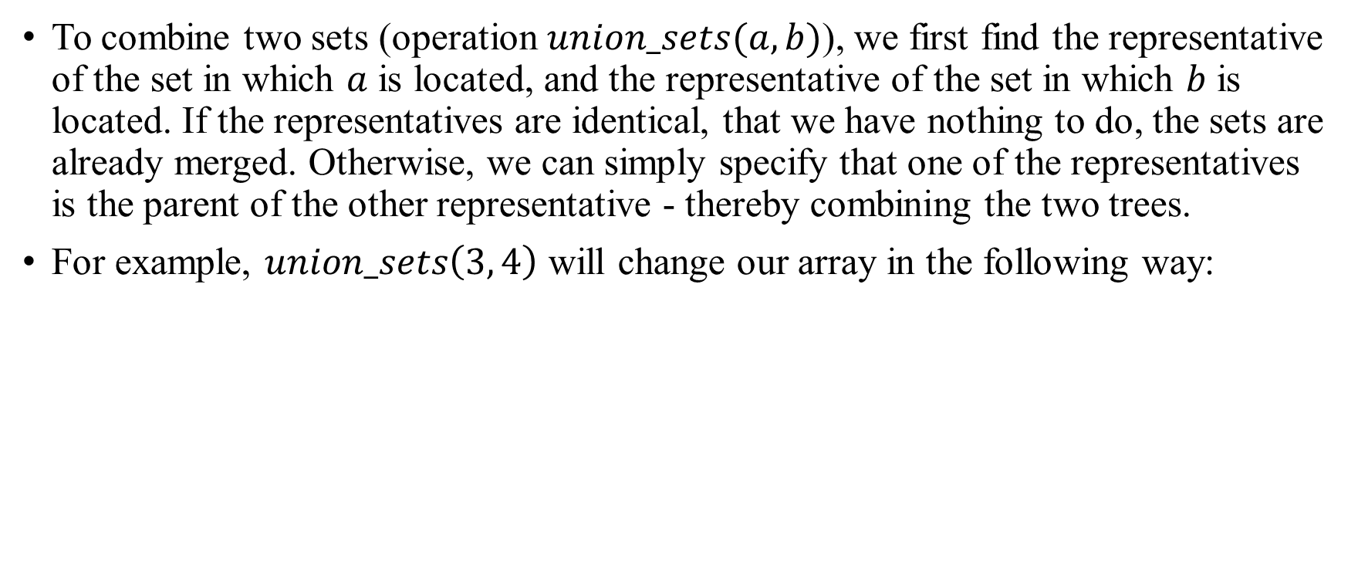
Disjoint set union (DSU)
To combine two sets (operation $union_sets(a, b)$), we first find the representative of the set in which $a$ is located, and the representative of the set in which $b$ is located. If the representatives are identical, that we have nothing to do, the sets are already merged. Otherwise, we can simply specify that one of the representatives is the parent of the other representative - thereby combining the two trees.
For example, $union_sets\left(3, 4\right)$ will change our array in the following way:
element | 0 | 1 | 2 | 3 | 4 | 5 | 6 | 7 | 8
parent | 0 | 1 | 5 | 3 | 3 | 5 | 6 | 7 | 8

Slide 15
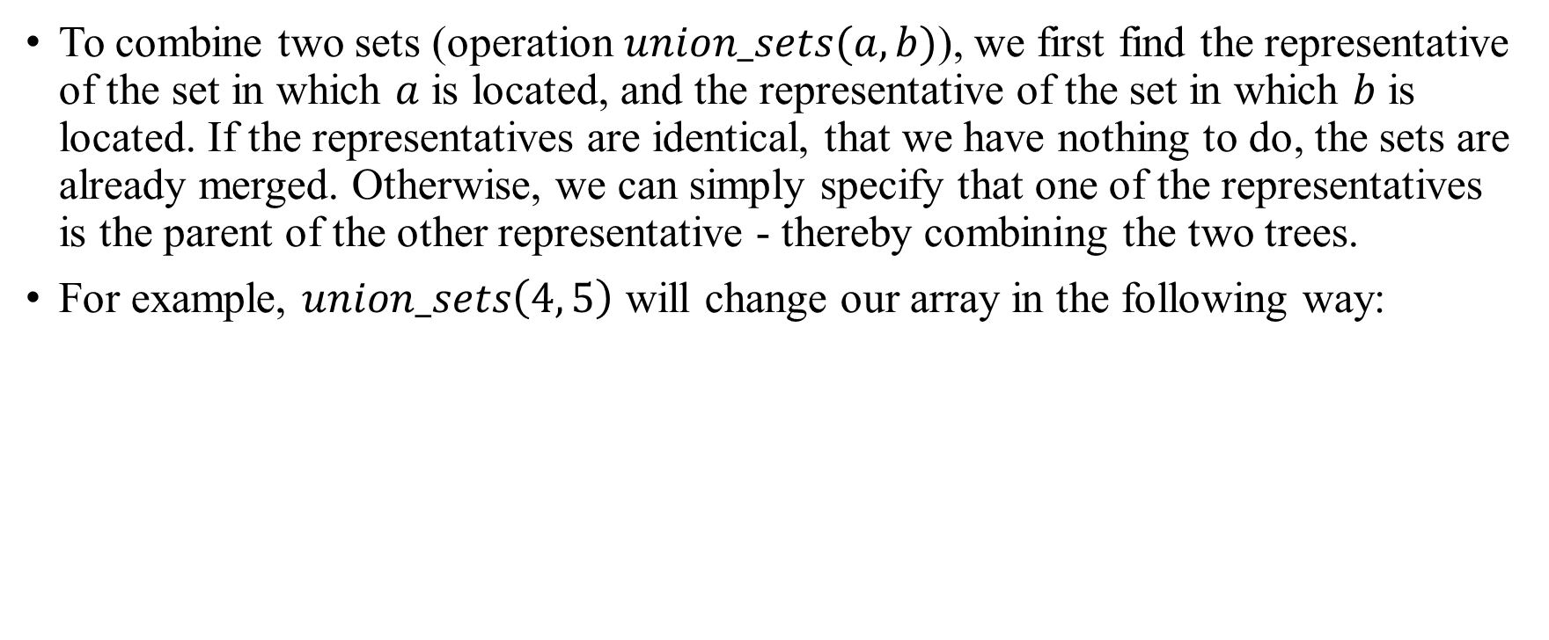
Disjoint set union (DSU)
To combine two sets (operation $union_sets(a, b)$), we first find the representative of the set in which $a$ is located, and the representative of the set in which $b$ is located. If the representatives are identical, that we have nothing to do, the sets are already merged. Otherwise, we can simply specify that one of the representatives is the parent of the other representative - thereby combining the two trees.
For example, $union_sets\left(4, 5\right)$ will change our array in the following way:
element | 0 | 1 | 2 | 3 | 4 | 5 | 6 | 7 | 8
parent | 0 | 1 | 5 | 3 | 3 | 4 | 6 | 7 | 8

Slide 16
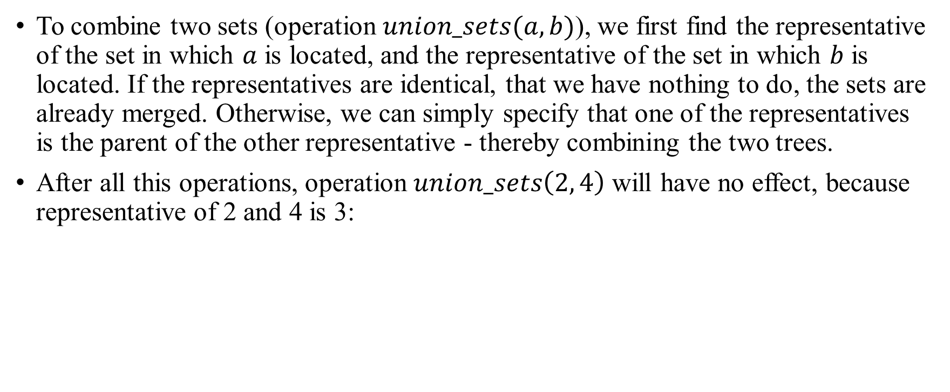
Disjoint set union (DSU)
To combine two sets (operation $union_sets(a, b)$), we first find the representative of the set in which $a$ is located, and the representative of the set in which $b$ is located. If the representatives are identical, that we have nothing to do, the sets are already merged. Otherwise, we can simply specify that one of the representatives is the parent of the other representative - thereby combining the two trees.
After all this operations, operation $union_sets\left(2, 4\right)$ will have no effect, because representative of 2 and 4 is 3:
element | 0 | 1 | 2 | 3 | 4 | 5 | 6 | 7 | 8
parent | 0 | 1 | 5 | 3 | 3 | 4 | 6 | 7 | 8

Slide 17

Disjoint set union (DSU)
Finally the implementation of the find representative function (operation $find_set(v)$): we simply climb the ancestors of the vertex $v$ until we reach the root, i.e. a vertex such that the reference to the ancestor leads to itself. This operation is easily implemented recursively.
For example, representative of 2 is 3: $2 →5 →4 →3$
element | 0 | 1 | 2 | 3 | 4 | 5 | 6 | 7 | 8
parent | 0 | 1 | 5 | 3 | 3 | 4 | 6 | 7 | 8

Slide 18
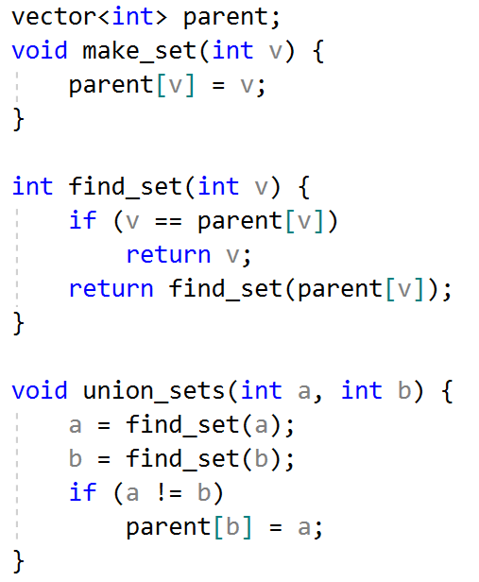
Disjoint set union (DSU) Implementation

Slide 19
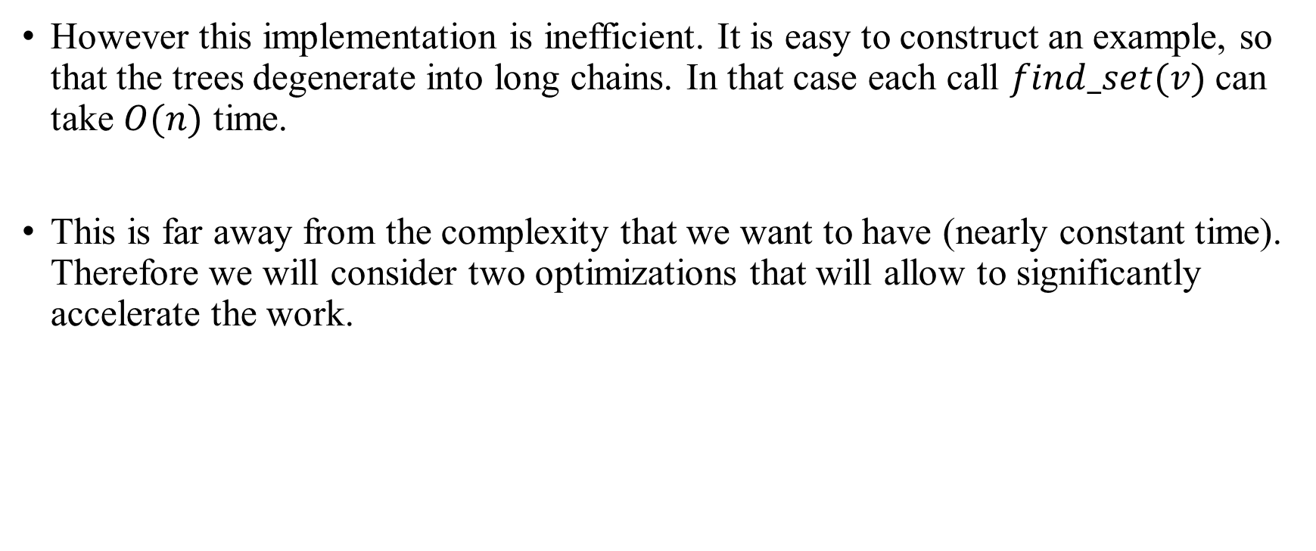
Disjoint set union (DSU)
However this implementation is inefficient. It is easy to construct an example, so that the trees degenerate into long chains. In that case each call $find_set(v)$can take $O(n)$ time.
This is far away from the complexity that we want to have (nearly constant time). Therefore we will consider two optimizations that will allow to significantly accelerate the work.

Slide 20
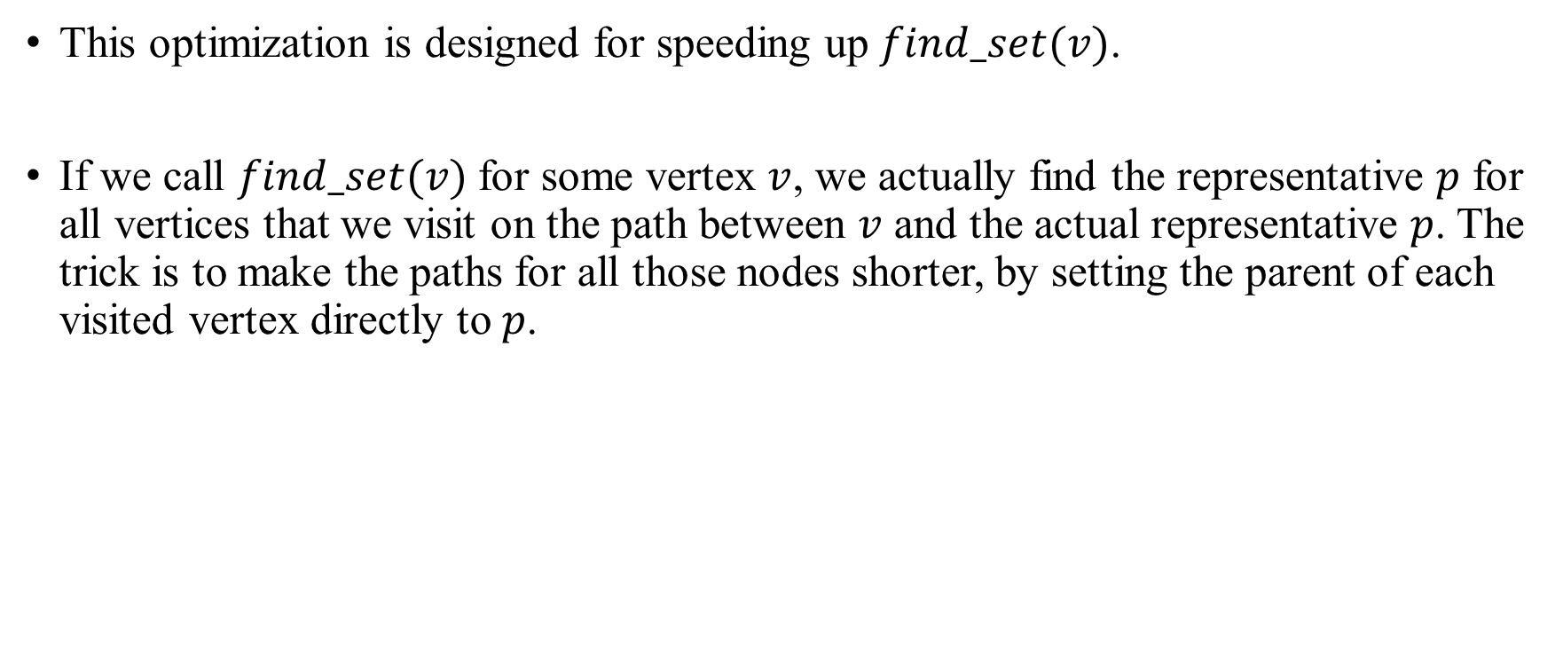
Disjoint set union (DSU) Path compression optimization
This optimization is designed for speeding up $find_set(v)$.
If we call $find_set(v)$for some vertex $v$, we actually find the representative $p$ for all vertices that we visit on the path between $v$ and the actual representative $p$. The trick is to make the paths for all those nodes shorter, by setting the parent of each visited vertex directly to $p$.

Slide 21

Disjoint set union (DSU) Path compression optimization
You can see the operation in the following image. On the left there is a tree, and on the right side there is the compressed tree after calling $find_set(4)$, which shortens the paths for the visited nodes 4, 5 and 3.
1
3
5
6
1
5
6
2
4
2
3
4

Slide 22
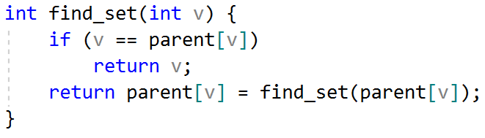
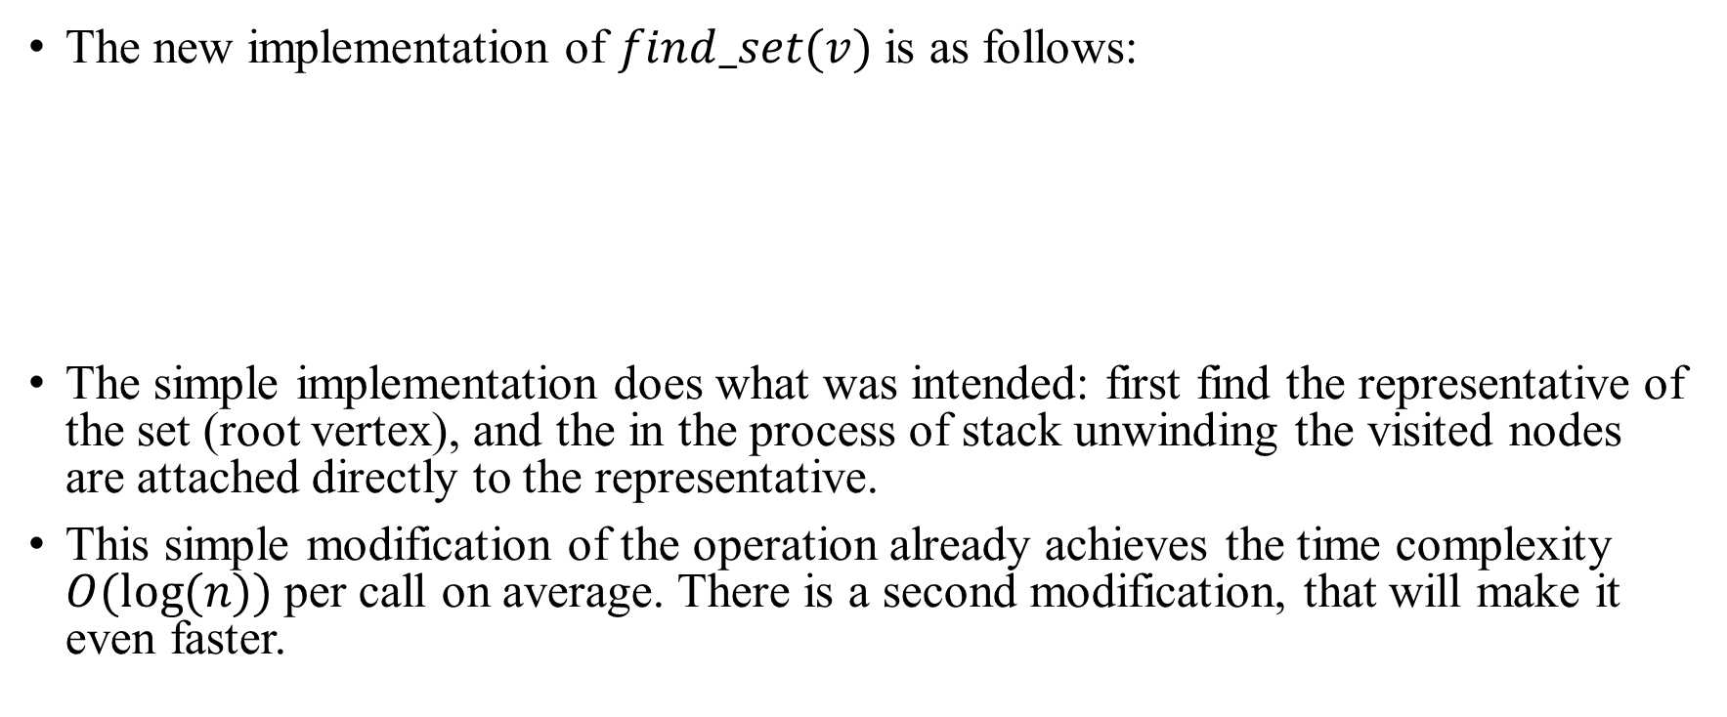
Disjoint set union (DSU) Path compression optimization
The new implementation of $find_set(v)$ is as follows:
The simple implementation does what was intended: first find the representative of the set (root vertex), and the in the process of stack unwinding the visited nodes are attached directly to the representative.
This simple modification of the operation already achieves the time complexity $O(log⁡(n))$per call on average. There is a second modification, that will make it even faster.

Slide 23
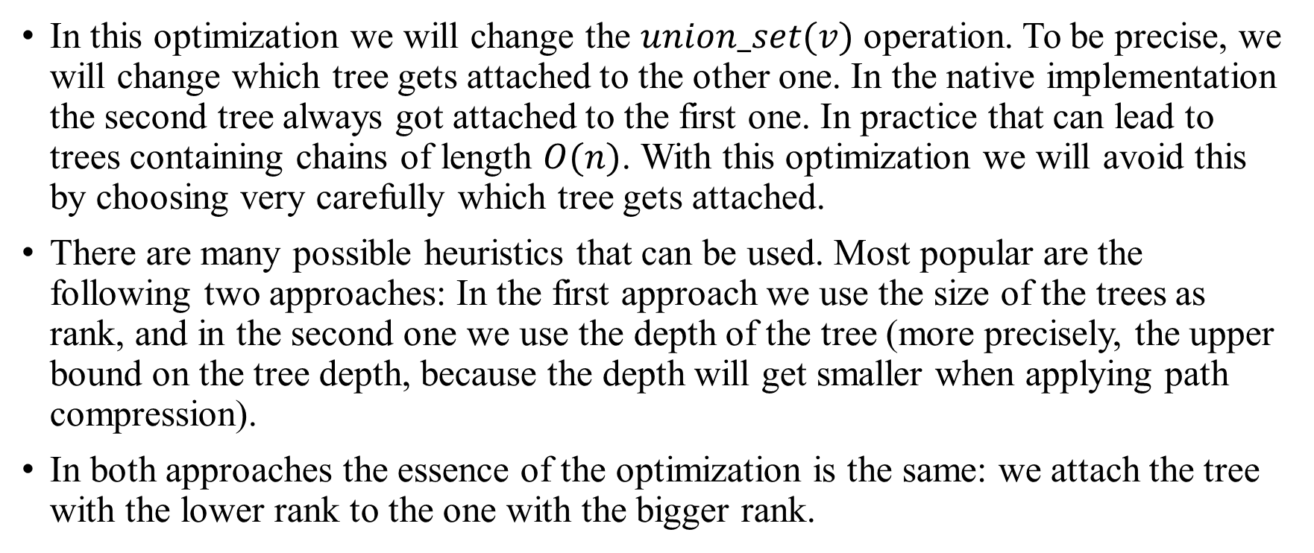
Disjoint set union (DSU) Union by size / rank
In this optimization we will change the $union_set(v)$ operation. To be precise, we will change which tree gets attached to the other one. In the native implementation the second tree always got attached to the first one. In practice that can lead to trees containing chains of length $O(n)$. With this optimization we will avoid this by choosing very carefully which tree gets attached.
There are many possible heuristics that can be used. Most popular are the following two approaches: In the first approach we use the size of the trees as rank, and in the second one we use the depth of the tree (more precisely, the upper bound on the tree depth, because the depth will get smaller when applying path compression).
In both approaches the essence of the optimization is the same: we attach the tree with the lower rank to the one with the bigger rank.

Slide 24
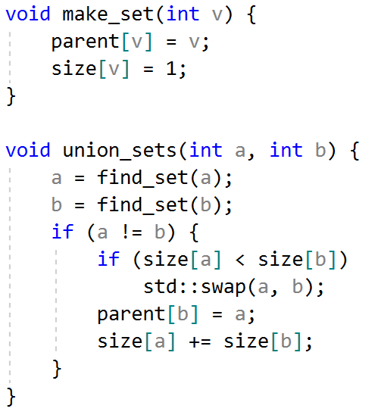
Disjoint set union (DSU) Union by size / rank
Here is the implementation of union by size:

Slide 25
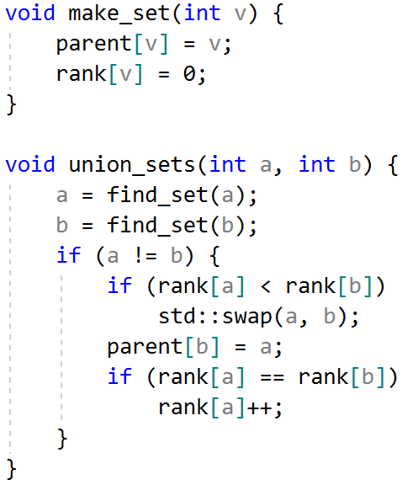
Disjoint set union (DSU) Union by size / rank
And here is the implementation of union by rank based on the depth of the trees:

Slide 26
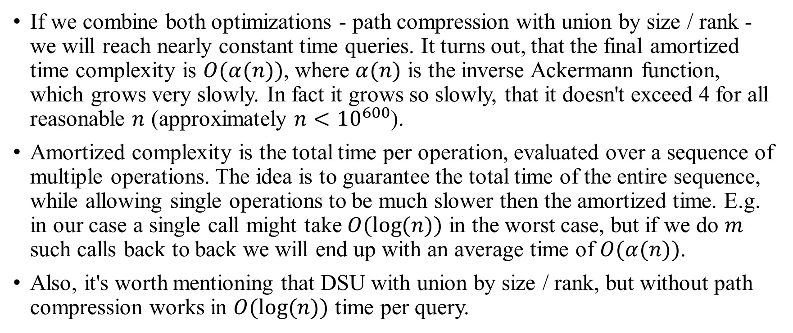
Disjoint set union (DSU) Complexity
If we combine both optimizations - path compression with union by size / rank - we will reach nearly constant time queries. It turns out, that the final amortized time complexity is $O(α(n))$, where $α(n)$ is the inverse Ackermann function, which grows very slowly. In fact it grows so slowly, that it doesn't exceed 4 for all reasonable $n$ (approximately $n<{10}^{600}$).
Amortized complexity is the total time per operation, evaluated over a sequence of multiple operations. The idea is to guarantee the total time of the entire sequence, while allowing single operations to be much slower then the amortized time. E.g. in our case a single call might take $O(log⁡(n))$ in the worst case, but if we do $m$ such calls back to back we will end up with an average time of $O(α(n))$.
Also, it's worth mentioning that DSU with union by size / rank, but without path compression works in $O(log⁡(n))$ time per query.

Slide 27
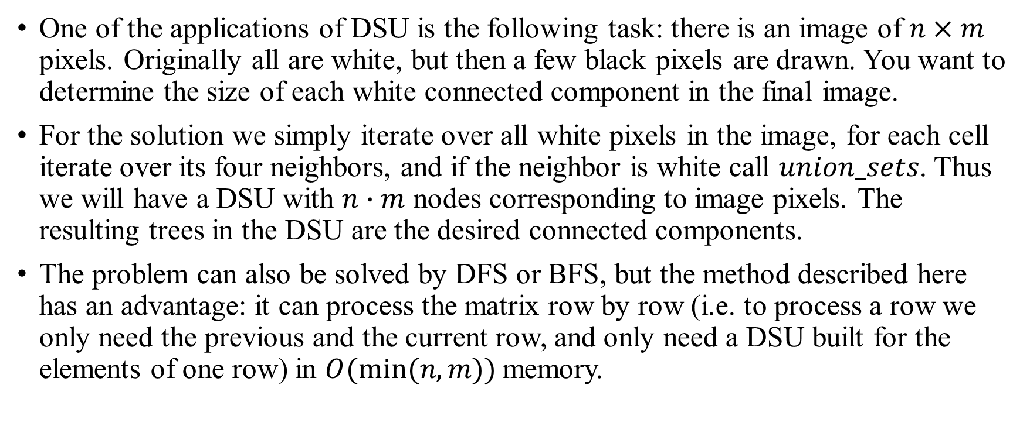
Disjoint set union (DSU) Applications: search for connected components in an image
One of the applications of DSU is the following task: there is an image of $n×m$ pixels. Originally all are white, but then a few black pixels are drawn. You want to determine the size of each white connected component in the final image.
For the solution we simply iterate over all white pixels in the image, for each cell iterate over its four neighbors, and if the neighbor is white call $union_sets$. Thus we will have a DSU with $n∙m$ nodes corresponding to image pixels. The resulting trees in the DSU are the desired connected components.
The problem can also be solved by DFS or BFS, but the method described here has an advantage: it can process the matrix row by row (i.e. to process a row we only need the previous and the current row, and only need a DSU built for the elements of one row) in $O(min⁡(n,m))$memory.

